Slide 1
Project

Slide 2
Project Period
Good
Bad

Slide 3
System Development plan
 | Week 16 | Week 17 | Week 18, 19, 20 | Week 21
Mon |  | Agile software requirements | Project | Comparison of methods Areas of knowledge + Experiments SP: Areas of knowledge + Experiments
Tue | Outsourcing SP: Outsourcing | Unified Process (UP) + use cases SP: UP and Use Cases |  | Choosing and adjusting a method
Wed | Agile methods | Prototyping - Spikes SP: Prototyping |  | Present SP: Areas of knowledge + Experiments Report writing Exam prep. questions
Thu | Extreme Programming (XP) | Test and TFD/TDD |  | Aflevering af rapport
Fri | Present SP: Outsourcing Exam prep. questions | Present SP: UP and Use cases Prototyping Exam prep. Questions Sprint planning
Each SP is 7 point – 28 in total
Each SP has to be presented orally to the teacher
Deadline Friday end of class

Slide 4

System Development Exam
30 minutes examination – no preparation
Grade based on:
SIP project rapport
Oral examination - You draw a question

Slide 5
Comparison of methods
TUHE 2017

Slide 6
Agenda
Generic systems development aspects
Classification of systems development methods
Process models
A generic view on systems development
Form groups for theoretical SIP report
Presentations next week!
Goal
Be able to compare and discus different systems development processes
Be able to classify Scrum and XP

Slide 7
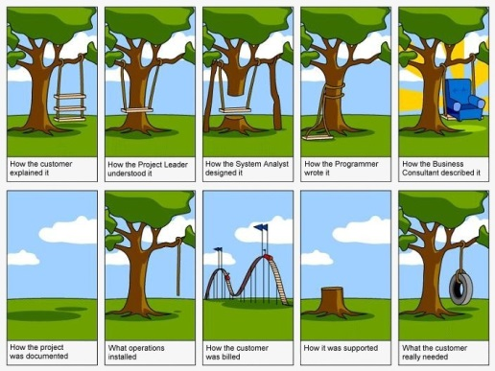
Systems development

Slide 8
Systems development
Visions and requirements
Systems
Development
process
To succeed we need a systematic approach concerning
The structure of the product
The process producing the product

Slide 9
Common questions?
Why do systems development take so long?
Exponentially increasing complexity
Why is development so costly?
Labor Intensive production!
Why are systems so flawed with errors?
Complexity and/or lack of maturity
The ability to maintain existing systems are threatened by bad design and insufficient resources (the classical problem)
The cost of integrating systems soar (the new problem)
We need guidelines to produce quality software

Slide 10
Generic view of systems development
Definition
Development
Maintenance
Pre analysis
Project planning
Requirement specification
Design
Implementation
Test
Correction
Adaption
Extension

Slide 11
How to choose an approach?
Situation
Define the Task at hand
Choose a process model which suits the task
Choose a method within the process model
Use the recommended techniques and tools
Process models
System development methods
Techniques
Tools
BUT …never be mechanistic:
Adapt the method
Perhaps combine methods
Be pragmatic
Focus on approaches that works
Remember:
“There is no silver bullet”
Death over standard methods!

Slide 12
Systems development and uncertainty
Systems development is a creative process!
Routine – Problem solving – Problem definition
In systems development many decisions are taken!
Start
Goal

Slide 13
Types of situations
Attributes in Relation to Situation | Assignment or problem | Working practice | Uncertainty
Routine | Known | Known | Small
Problem solving | Known | Unknown | Intermediate
Problem setting | Unknown | Unknown | Large

Slide 14
Systems development and uncertainty
Problem definition situations are characterized by symptoms, it is important to identify the problem / task behind
Problem solution situations are open, often requires an experimenting and searching approach
Routine Situations are 'easy' to handle, but may require extensive and qualified effort
High
uncertainty
 | The task is known | The solution is known
Problem definition | no | no
Problem solving | yes | no
Routine | yes | yes
Low
uncertainty

Slide 15
Methods and systems development theory
Methods have a more or less defined scope
Methods have an underlying perspective
Methods provides guidelines for how the process should proceed:
The sequence in which to carry out the functions
The artefacts to produce
Experience is essential for system developers
Methods are experience put in patterns
Methods are not practical if the situation does not fit
General knowledge – systems development theory
Method Independent understanding of systems development

Slide 16
Ideal and reality
Many methods build on a rational ideal:
Common and clearly defined goals
Adequate and accessible resources
Developers can analyse their way to relevant designs and predict their consequences
System developments projects in real life:
Starts without clearly defined goals
Design decisions are taken without analysis of alternatives
Great complexity
Changing requirements
…

Slide 17
Process models and Methods
Methods have a more or less defined scope
Methods have an underlying perspective
Methods provides guidelines for how the process should proceed:
The sequence in which to carry out the functions
The artefacts to produce
Process models is a grouping of methods with similar characteristics
Process models are also called paradigms

Slide 18
Describing system development
Function
Most abstract way of
looking at a system development
Concrete Abstract
point of view point of view
Activity
What is actually done
Task
Concrete description
Of an intention
Process
Most concrete description of
What actually happens
Intention Actual performance
with the job of job

Slide 19
Exercise
Discuss project situations
Choose at least 2 typical situations from your last project.
Some of the situations should be concerned with actual project performance, other with project management
Characterize each situation as either routine, problem-solving or problem-setting situation
Discuss the working practices applied, and whether seeing the situations as either routine, problem-solving, or problem-setting situations helps you to consider more expedient working practices.

Slide 20
What’s a process model and a method?
Process models are differentiated by their sequence of activities
For instance, first full analysis, then design …
Methods are differentiated by the content of the activities
For instance:
Which activities are carried out during design?
Which models are made during analysis?

Slide 21
How to choose an approach?
Situation
Define the Task at hand
Choose a process model which suits the task
Choose a method within the process model
Use the recommended techniques and tools
Process models
System development methods
Techniques
Tools
BUT …never be mechanistic:
Adapt the method
Perhaps combine methods
Be pragmatic
Focus on approaches that works
Remember:
‘There is no silver bullet’
Death over standard methods!

Slide 22
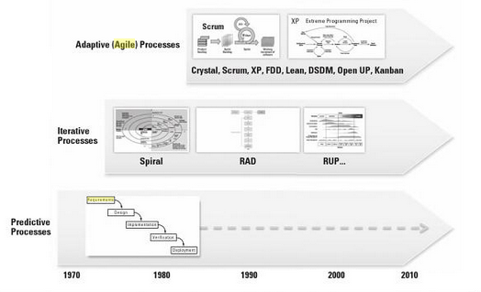
Process models (paradigms)

Slide 23
Process models
Process model
Predictive
Iterative and incremental
Agile/Adaptive
SA/SD
OOSE
x
Spiral
UP
XP
Scrum

Slide 24
Waterfall, predictive, plan driven - “The devil” is known by many names ☺
Known goals/tasks
Maintenance
Large systems
Division of work
Requirements
Design
Implementation
Verification
Deployment

Slide 25
Waterfall, predictive, plan driven
The process model presupposes requirements can be specified ”up front”
Cost and time can thus be estimated based on the requirements
Fixed price contract
But what about quality?
Better than ”code ‘n’ fix”
Immediately logical and predictable
Most software is developed like this
Fixed price contract is a must
Requirements
Plan
Driven
Cost
Time

Slide 26
Problems with the waterfall model
31 % of projects were cancelled before completion
53 % of the projects will cost more than 189% of their estimates
Only 16 % of projects are completed on time and budget
Completed projects delivered only 42% of the original requirements
Ineffective treatment of requirements is the primary cause of cancelled projects:
13% of projects lack user input
12% of projects have incomplete requirement specifications
12% of projects have changing requirement specifications

Slide 27
Iterative and incremental processes
Advanced development tools and technologies
Increased ‘time-to-market’ pressure
Need for new innovative exploration based methods
Generic model for iterative and incremental methods
Spiral model: Experimental exploration
Methods
RAD (Rapid Application Development): Development of prototypes with advances tools
UP: Iterative and incremental development of big and complex systems

Slide 28
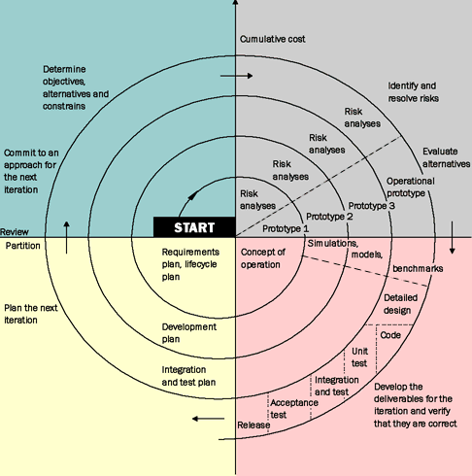
Spiral model - iterative og incremental
Boehm 1988
The first published
iterative og incremental method
Accept of change of requirements
Focus on continuous feedback
Gradually expansion of the system through prototypes

Slide 29
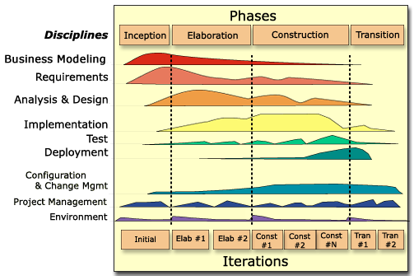
Unified Process

Slide 30
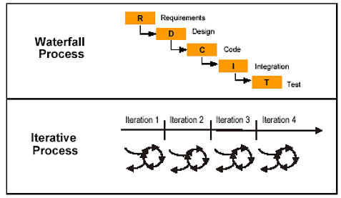
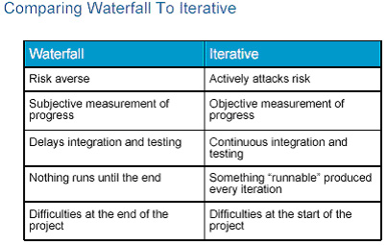
Waterfall vs. Iterative Process
There can be feedback loops between these steps, but the dominant practice is that a particular discipline is mostly completed before moving on to the next discipline.
In an iterative process you accomplish a small amount of each of the disciplines (requirements, analysis, design, implementation, and testing) in every iteration
Kilde: http://www.ibm.com/developerworks

Slide 31
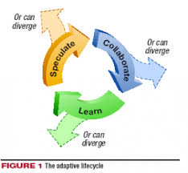
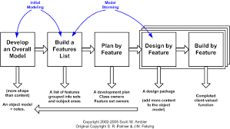
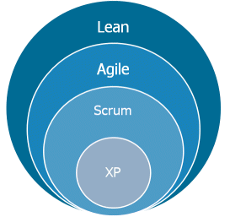
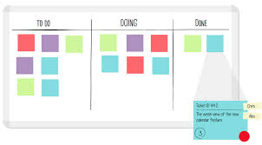
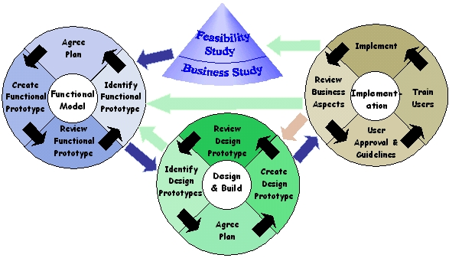
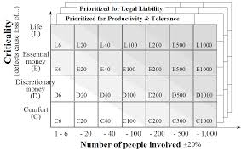
Agile (adaptive) processes

Slide 32
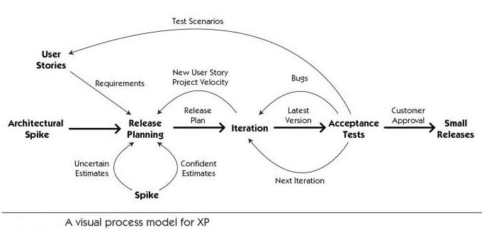
XP - agile

Slide 33
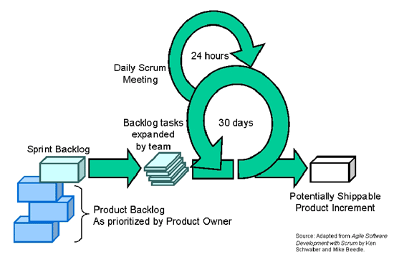
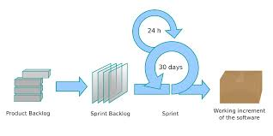
Scrum - Agile

Slide 34
Value driven instead of plan driven
Goodbye to the iron triangle
Waterfall
Agile
Requirements
Resources
Time
Plan
Driven
Determined
Value
Driven
Estimated
Cost
Time
Requirements

Slide 35
Sub functions of systems development
Performance
Management
Analysis
Design
Realisation
Evaluation
Planning
Regulation
General
Decision-making
Communication
Socialisation

Slide 36
Main components of systems development -A methodology independent description
Visions
Present
reality
Visions
Present
reality
Reflec-
tion
Design
Analysis
Planning
Evaluation
Action
Realisation
Regulation
Product-oriented
Process-oriented

Slide 37
Systems development - General
Decision-making
Can take time
Can delay the progress
Communication
Man – man
Group – group
Man – machine
Content, form, location
Socialising
Intern informal contracts
Project establishment – more formal contracts

